Slide 1
B3 Flash Cards

Slide 2
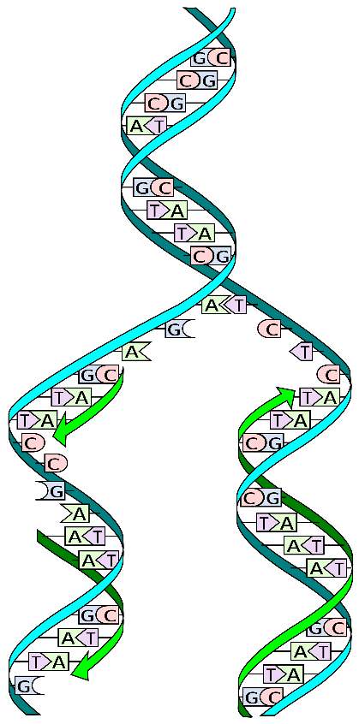
DNA
Double helix structure made up of 4 bases
Complementary base pairing A-T, C-G
Watson & Crick built a model of DNA
Using x ray data to show the double helix
Other scientists had to test their data
DNA Replication (happens before cell division)
DNA unzips
Free bases pair up
2 identical copies made

Slide 3
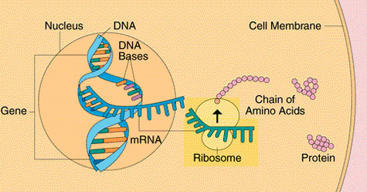
Proteins
Protein synthesis:
A gene codes for a protein
Every 3 bases is a code for 1 amino acid
mRNA takes the code to the ribosomes (as DNA is stuck in the nucleus)
Ribosomes make proteins (ribosomes are too small to be seen by a microscope)
Genes are turned on or off as the proteins are needed
Mutations are changes in the bases that will change the protein
Types of proteins
Structural (e.g. Collagen)
Hormones (e.g. Insulin)
Carrier molecules (e.g. Haemoglobin)
Enzymes

Slide 4
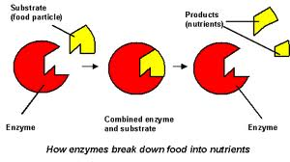
Enzymes
Biological catalyst (speed up reactions)
Specific to a substrate (only breaks down one thing)
Temperature affects enzymes
Enzymes more slower at low temperatures
If they get too hot they denature
their active site changes shape
pH affects enzymes
If the pH is different from the optimum the enzyme denatures
Q₁₀ (given equation) temperatures must be 10ºC apart

Slide 5
Respiration
Aerobic Respiration: C6H12O6 + 6O2 → 6CO2 + 6H2O
Energy is made as ATP
Needs enzymes
Anaerobic Respiration: Glucose → Lactic Acid
Lactic acid builds up in muscles causing cramp (oxygen debt)
Breathe hard after exercise to replace oxygen
Increased heart rate to take lactic acid to the liver
RQ (given calculation)
As cells respire more you make more CO2 and use up more O2

Slide 6
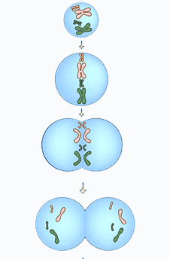
Cell Division
Advantages of being multicellular
Larger & more complex
Specialised organ systems to supply cells with nutrients
Mitosis (cell division in body cells: diploid)
Chromosomes line up in the centre
Chromosome copies divide & pulled to poles
Meiosis (cell division in gametes)
Chromosome pairs line up and one is pulled to each pole
Chromosomes line up and copies pulled to poles
Sperm cells are adapted
Mitochondria to make energy
Acrosome to release enzymes to digest egg membrane

Slide 7
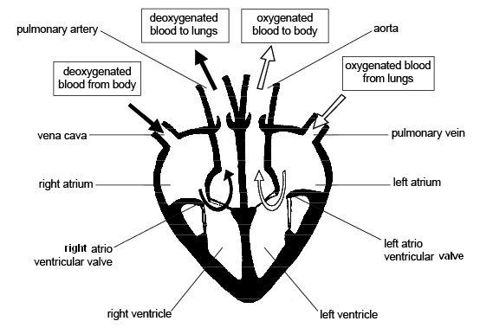
Heart
Advantages of double circulatory system
Higher pressures
Greater rate of flow
Heart adaptations
Valves to prevent back flow of blood
Thick muscle of LV to create higher pressure

Slide 8
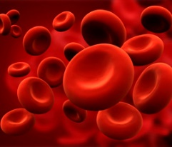
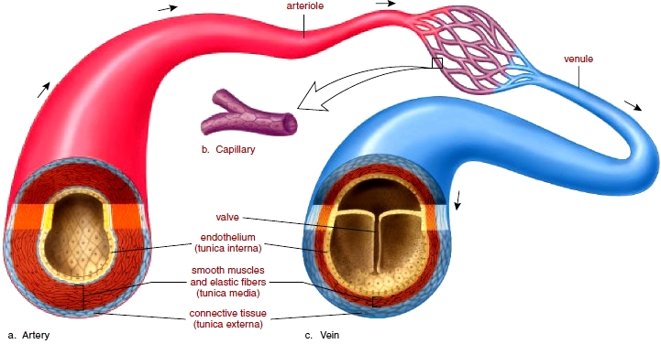
Blood & Blood Vessels
Adaptations of Red Blood Cells
Large SA:Vol (biconcave shape)
Lots of haemoglobin to bind with oxygen (oxyhaemoglobin)
Arteries
Transports blood away from the heart
Thick muscular & elastic walls
Veins
Transports blood towards the heart
Large lumen & valves
Capillaries
Exchange materials with tissues
Thin, permeable walls

Slide 9
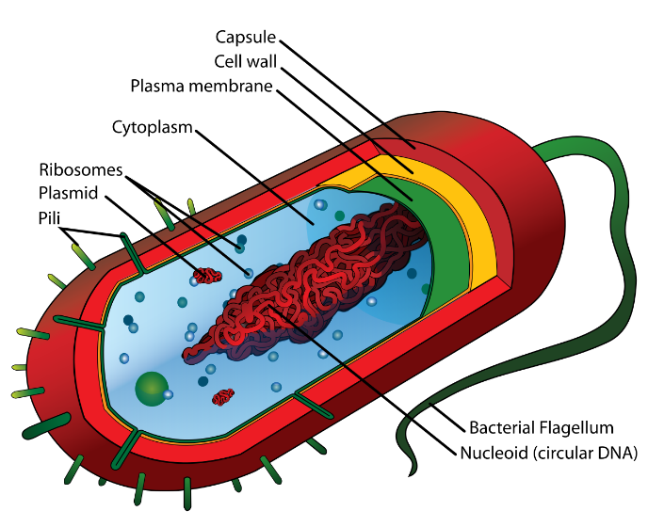
Growth
Bacterial Cells
No nucleus & loop of DNA
Measuring Growth
Length A: easy D: doesn’t take into account width
Wet Mass A: easy D: water levels will effect it
Dry Mass A: accurate D: have to kill organism
Stem Cells
Undifferentiated (can become specialised)
Adults stem cells turn into blood cells
Embryonic stem cells can turn into anything
Plant vs Animal Growth
Animals: finite size, cells loose ability to differentiate
Plants: grow continuously, cells get bigger, can always differentiate (so easier to clone)

Slide 10
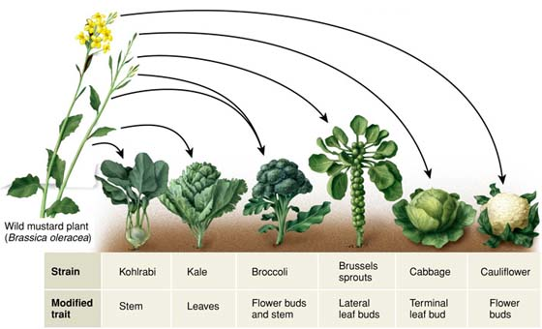
Selective Breeding & Gene Therapy
Selective Breeding
Pick individuals with desired characteristics
Breed together
Pick individuals with desired characteristics from offspring
Repeat
Disadvantage of Selective Breeding
Inbreeding leads to build up of recessive characteristics
Reduction in gene pool
Gene Therapy
Changing a person’s genes to cure disorders
Body cells or gametes altered
If change gametes change all future variations

Slide 11
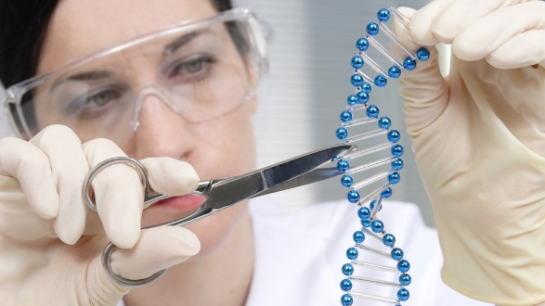
Genetic Engineering
Process of GE
Isolate gene want
Insert gene into organism’s DNA
Replicate organisms
Advantages of GE: Produce organisms with features you want quickly
Risks of GE: Unexpected harmful effects
Examples of GE
Golden Rice (take beta carotene gene from carrots and put into rice)
Human insulin (take insulin gene from humans and put into bacteria)
Give crops resistance to herbicides, frost damage & disease

Slide 12
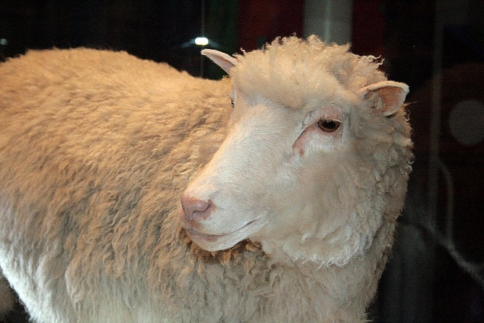
Cloning Animals
Making Dolly the Sheep with Nuclear Transfer
Nucleus removed from egg cell
Replaced with nucleus from udder cell
Electric shock to cause cell division
Embryo implanted into surrogate
Embryo is a clone of the sheep the udder cell came from
Uses of Cloning Animals
Making lots of animals with characteristic you wanted
Make animals that have been GE to make human products
Make embryos for stem cell therapy

Slide 13
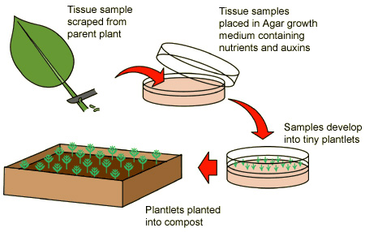
Cloning Plants
Cloning Plants with Tissue Culture
Small piece of tissue
Placed into growth medium
Aseptic technique
Advantages of Plant Cloning
Has characteristic you wanted
Mass produce plants that are difficult to grow from seed
Disadvantages of Plant Cloning
Disease could kill them all
Lack of genetic variation

