Slide 1
C4 revision
Atomic structure
Periodic table
Electronic structure
Group 1 (alkali metals)
Flame tests
Group 7 (halogens)
Ionic bonding and ionic compounds
Covalent bonding
Metallic bonding and metals
Transition metals
Superconductors
Precipitation reactions
Purifying and testing water

Slide 2
Atomic structure
Results of lots of experiments led to changing ideas about the structure of the atom
Subatomic particle | Relative charge | Relative mass
Proton | +1 | 1
Neutron | 0 | 1
Electron | -1 | 0.0005
John Dalton… theorised atoms were solid spheres
JJ Thomson… theorised atoms were like a plum pudding and discovered the electron
Ernest Rutherford… conducted the gold foil experiment and discovered atoms were mainly empty space, he theorised the centre of the atoms was a tiny positively charged nucleus.
Niels Bohr… theorised that electrons exist in shells/orbits.
Electrons in shells
Ions – an atom that has lost or gained electrons.
(+ = lost - = gain)
The number of protons and neutrons stays the same.
Nucleus contains protons and neutrons

Slide 3
Periodic table
History of the Period Table
Johann Wolfgang Dobereiner – Law of Triads… arranged elements in groups of 3 based on their similar chemical properties. The mass of the 2nd element was the average of the mass of the 1st and 3rd in the triad.
John Newlands – Law of Octaves… arranged elements in rows of 7 in order of increasing atomic mass. He said that every 8th element had similar chemical properties. He mixed metals and non-metals and unfortunately, his theory did not work for all elements.
Dmitri Mendeleev – Modern Day Period Table… arranged elements in order of increasing atomic mass (like Newlands). He left gaps for undiscovered elements. Elements with similar chemical properties were in vertical groups. He left out Hydrogen as it did not fit the pattern.
1
2
8
3
4
5
6
7

Slide 4
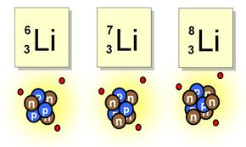
Periodic table
Number of protons + neutrons
Number of protons
Groups are the columns
1
2
8
3
4
5
6
7
4
2
He
Helium
Periods are the rows
Isotopes are different types of one element that have the same atomic number but different mass number (different amounts of neutrons)

Slide 5
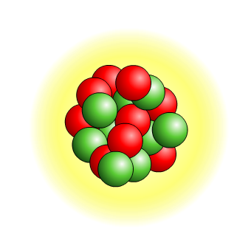
Electronic structure
You can tell the number of electrons by using the periodic table
Group number = how many electrons in outer shell
Period number = how many shells there are
1st shell holds 2
2nd shell holds 8
3rd shell holds 8
2.8.2

Slide 6
Group 1 - Alkali metals
Least reactive
They are called alkali metals because they react vigorously with water to form an alkaline solution
They are stored in oil as they are so reactive – it prevents contact with water or air
They all have one outer electron – this is why they have similar properties.
When they react they lose this electron and become positive ions e.g. Na⁺
Sodium + water → sodium hydroxide + hydrogen
2Na + 2H₂O → 2NaOH + H₂
Most reactive
The lower down, the more easily they lose electrons. Losing electrons is called oxidation
OIL RIG → Oxidation is Loss, Reduction is Gain

Slide 7
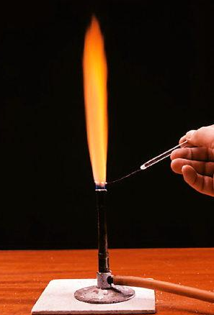
Flame tests
Used to identify unknown compounds
Put wire loop into the compound, then into the flame. The colour of the flame shows which element is present.
Lithium (Li⁺) | Red flame
Sodium (Na⁺) | Orange flame
Potassium (K⁺) | Lilac flame

Slide 8
Group 7 – Halogens
Chlorine is used to sterilise tap water and swimming pools as it kills bacteria. Also in pesticides and plastics (PVC).
Iodine is used as an antiseptic to sterilise wounds.
Most reactive
They all have 7 outer electrons – this is why they have similar properties.
When they react they gain one electron and become negative ions e.g. Cl⁻
Chlorine = Green gas
Bromine = Orange liquid
Iodine = Grey solid (purple vapour)
Group 7 react with group 1 vigorously as group 1 wants to lose an electron and 7 wants to gain one
Sodium + chlorine → sodium chloride
2Na + Cl₂ → 2NaCl
Least reactive
The higher up, the more easily they gain electrons. Gaining electrons is called reduction
OIL RIG → Oxidation is Loss, Reduction is Gain

Slide 9
Ionic bonding
Ions are charged particles, they are either:
Positive – if they lose electrons – e.g. Cu²⁺, Na⁺
Negative – if they gain electrons – e.g. O²⁻, Cl⁻
Formulae of ionic compounds:
Positive and negative have to cancel out
Na⁺ and Cl⁻
Charges cancel out to make NaCl
Cu²⁺ and Cl⁻
You would need two Cl- to cancel out the Cu2+ so makes CuCl2
Mg²⁺ and O²⁻
Charges cancel out to make MgO
Mg²⁺ and Cl⁻
You would need two Cl- to cancel out so MgCl₂
Ionic bonding = metals and non-metals
Metal gives away his electron to the non-metal
This means both have complete outer electron shells which makes them stable
Positive metal ion attracted to negative non-metal ion
Chlorine: Gains an electron to become Cl-
Sodium: Loses an electron to become Na+
Na+ is attracted to Cl-
→ NaCl

Slide 10
Ionic compounds
Giant ionic lattice:
Ions arranged in a regular way, repeated many times
Positive ions attracted to negative ions, forming strong bonds
This means they have high melting points
They can conduct electricity when molten or in solution as the ions are free to move.
Magnesium Oxide | Sodium Chloride
High melting point (strong bonds) – used in fire-resistant materials | High melting point (strong bonds)
Insoluble in water | Dissolves in water
Conducts electricity when molten (ions free to move) | Conducts electricity when molten and in solution (ions free to move)

Slide 11
Mg²⁺
K⁺
Ca²⁺
Al³⁺
Rb⁺
I⁻
Br⁻
Cl⁻
O²⁻
S²⁻
N³⁻
Find the formula for:
Potassium iodide,
Calcium bromide
Aluminium chloride
Rubidium oxide
Aluminium sulphide
Magnesium nitride
Group | Charge
1 | +
2 | 2+
3 | 3+
5 | 3-
6 | 2-
7 | -

Slide 12
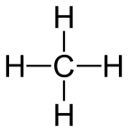
Covalent Bonding
Non-metals form covalent bonds (a shared pair of electrons)
Carbon dioxide and water are simple covalent molecules.
Strong covalent bonds
Weak intermolecular forces = low melting points
Cannot conduct electricity as electrons not free
Name | Molecular formula | Structural formula
Water | H₂O
Carbon dioxide | CO₂
Methane | CH₄
So they share electrons

Slide 13
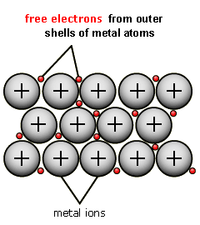
Metallic Bonding
Most elements are metals:
Hard
Shiny
Good conductors of heat and electricity
High tensile strength (resist stretching)
High melting and boiling points (strong bonds)
Positive metal ions closely together
Sea of free (delocalised) electrons
Strong attraction between metal ions and electrons =
Very strong bonds
Examples:
Copper conducts electricity so is used in electrical wiring
Iron is strong so is used to make cars and bridges

Slide 14
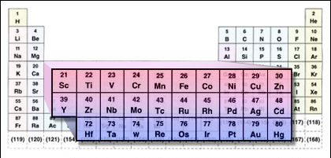
Transition elements
Elements between groups 2 and 3
All metals
shiny, strong, malleable
Form coloured compounds
Copper blue
Iron (II) light green
Iron (III) orange-brown
Can be used as catalysts
Thermal decomposition reactions:
One substance breaks down into two
Metal carbonate → metal oxide + carbon dioxide
Copper carbonate → copper oxide + carbon dioxide
CuCO₃ → CuO + CO₂
The test for carbon dioxide is limewater turning cloudy

Slide 15
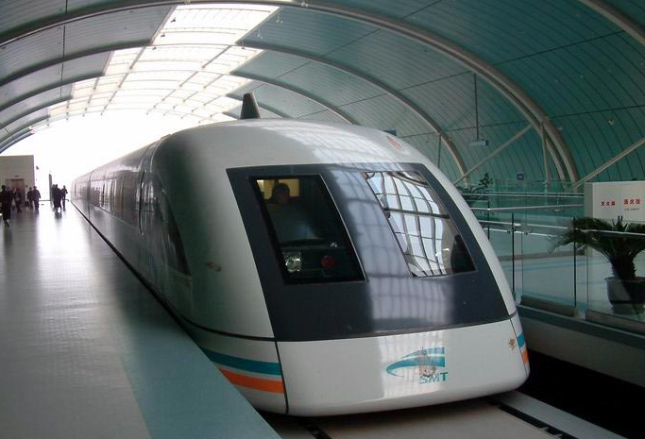
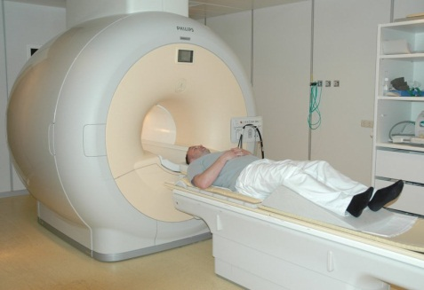
Superconductors
Resistance:
Metals contain delocalised (FREE) electrons
These move throughout the structure
Metals conduct electricity when electrons move BUT other electrons and ions get in the way
This is resistance – it makes metals heat up when they conduct electricity, wasting energy
Resistance decreases as temperature decreases.
Some metals are superconductors at very low temperatures
These have little or no resistance – so less energy is wasted.
Uses:
Powerful electromagnets
Metal cables to carry electricity from power stations
MRI scanners, powerful computers
High speed trains
Drawbacks:
Work at very low temperatures
E.g. aluminium -272C
This means applications are limited.
Scientists are developing superconductors at room temperature (20C)

Slide 16
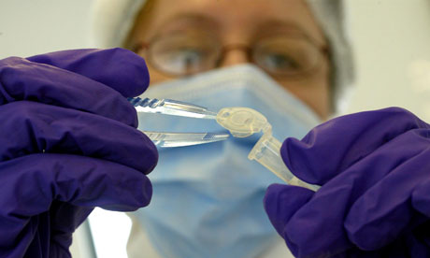
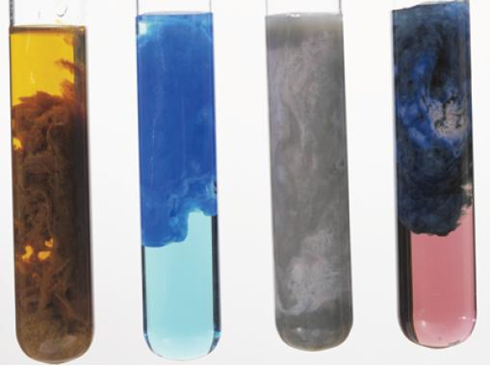
Precipitation reactions
Precipitation reactions are one way to identify metal ions in solution
They happen when a mixture of solutions react to make an insoluble solid.
The solid is the precipitate.
It makes the mixture cloudy.
Different metal ions give different colour precipitates
Forensic scientists wear masks, gloves and protective clothing
Hydroxide precipitates:
When a metal compound dissolves in water the ions separate out
Metal ions react with hydroxide ions (OH-) to form metal hydroxide precipitates
Cu²⁺ + 2OH⁻ → Cu(OH)₂
Copper blue
Iron (II) grey-green
Iron (III) orange-brown

Slide 17
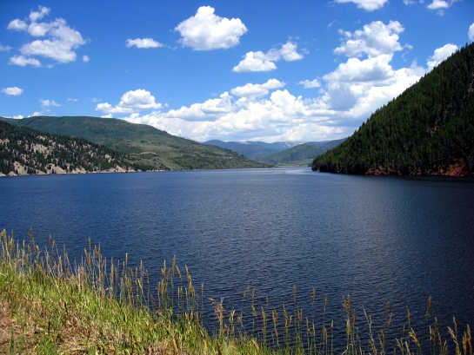
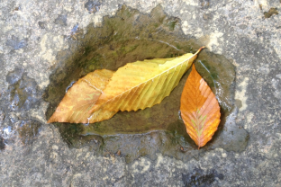
Purifying water
Water comes from lakes, rivers, reservoirs and aquifers.
Water contains:
Leaves
Salts and minerals
Microbes
Pollutants (nitrates from fertilisers, lead from pipes, pesticides from crops)
Sedimentation
Removes large particles e.g. sand and soil
DOES NOT REMOVE FERTILISERS AS THEY ARE SOLUTBLE
Filtration
Removes small particles e.g. clay
DOES NOT REMOVE LEAD (LEAD PIPES) AS THEY ARE SOLUTBLE
Chlorination
Kills microbes
Water is used in industry as:
Solvent to dissolve other substances
Coolant to stop overheating
Cheap raw material
Very pure water can be made by distillation of sea water – BUT – Lots of energy is needed and it is too expensive

Slide 18
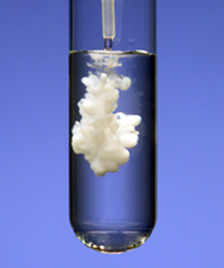
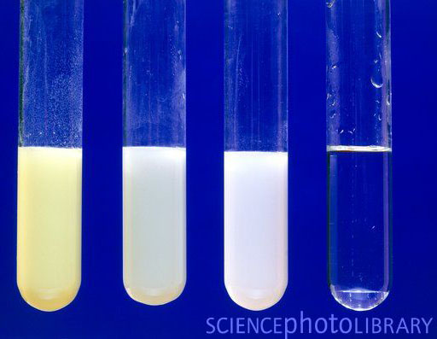
Testing water
The presence of dissolved ions in water can be detected using simple tests:
Testing for sulphate ions
Sample of water put into test tube, then add barium chloride
If sulphate ions are present there will be a white precipitate
Testing for halide ions
Sample of water put into test tube, then add silver nitrate
Chloride ions = white precipitate
Bromide ions = cream precipitate
Iodide ions = yellow precipitate
Sodium sulphate + barium chloride → sodium nitrate + silver chloride
Na₂SO₄ + BaCl₂ → 2NaCl + BaSO₄
Sodium chloride + silver nitrate → sodium nitrate + silver chloride
NaCl + AgNO₃ → NaNO₃ + AgCl

