Slide 1
P4 Flash Cards

Slide 2
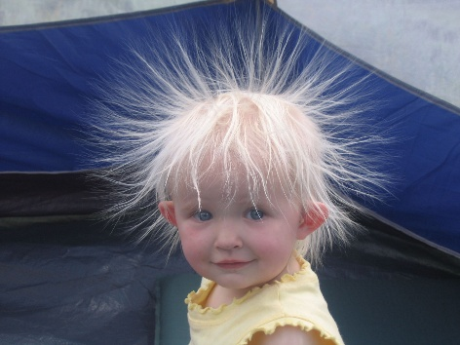
Static Electricity
Movement of electrons. One thing loses electrons (becomes positive), one thing gains electrons (becomes negative).
Can be a dangerous:
Inflammable gases could explode
Can be a nuisance:
Dust attracts to TV (anti static sprays create a conductive layer)
Clothing ‘clings’
Reduce chance of having a shock
Correct earthing/insulating mats/bonding fuel tanker to aircraft

Slide 3
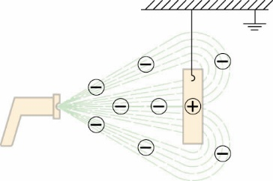
Uses of Electrostatic
Dust precipitators
Charged grids, charge up the dust
Dust particles attract to plates
Plates are struck and dust falls
Paint Spraying
Spray gun is charged
Paint has same charge so it repels creating fine spray
Paint attracts to the oppositely charged item to give an even coat
Defibrillator
Paddles charge and static passed through the chest

Slide 4
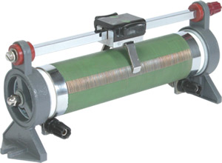
Resistance
Increasing resistance:
Longer wires
Thinner wires
Relationships
Current increases as voltage increases
Current decreases as resistance increases
Triangle: voltage (V)________
resistance (Ohms) x current (A)

Slide 5
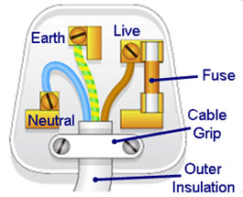
Plugs
Functions of wires:
Live (brown) – carries voltage
Neutral (blue) – completes circuit
Earth (green/yellow) – stop appliance becoming live
How a fuse works:
Current is too large and fuse melts
Current won’t flow so appliance won’t catch fire
Houses have re-settable fuses
Double insulated:
No earth wire, appliance can’t become live
Triangle: Power (W)______
Voltage (V) x Current (A)

Slide 6
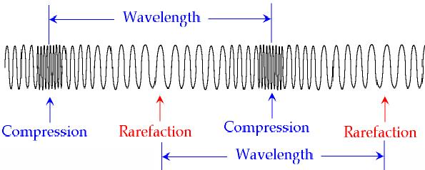
Ultrasound
Longitudinal Wave
Back & forth movement
Compression (region of high pressure)
Rarefaction (region of low pressure)
Human Hearing
Can hear ultrasound as too high frequencies
Treatments using Ultrasound
Body scans (reflects off different layers)
Breaking down kidney stones
Better than X rays as it can see soft tissue & not damage cells

Slide 7
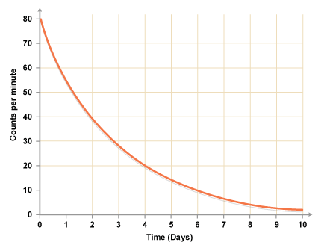
Radioactivity
Ionisation
Removal or gain of electrons from particles
Half Life
Amount of time it takes for half of nuclei to decay
Types
Alpha (Helium nucleus), Beta (electron) & Gamma (wave)
Alpha Decay
⁴₂He given out, new element formed
Beta Decay
One neutron turns into one proton and an electron

Slide 8
Use of Radioisotopes
Background Radiation
Some is man made: from industry & hospitals
Tracers in Industry
Gamma put into pipe (as most penetrating)
Detected above ground
Leak shown by increase, then decrease. Blockage shown by no radiation
Smoke Detectors
Alpha radiation ionises the air, smoke blocks this
Current is reduced causing an alarm to sound
Radioactive Dating
Uranium:Lead ratio (more lead = older)
Carbon 14 hasn’t changed for thousand of years, as wood decays the Carbon 14 in the sample decreases

Slide 9
Treatment
X Rays
Made by firing high speed electrons at metal
Easier to control than gamma
Tracers to see into the body
Beta/Gamma with short half life
Injected/eaten
Detected on outside
Gamma used to treat cancer
Source gives out gamma rays are focused on tumour
Wide beam used & rotated around tumour (in the centre)
Limits damage to healthy tissue

Slide 10
Fission
Nuclear Power Station
Nuclear reaction produces heat to make steam
Steam turns a turbine driving a generator
Uranium
Uranium nucleus hit by neutron and it splits
Energy and more neutrons released (start of chain reaction)
Rods are placed in reactor to absorb some of neutrons
Nuclear Bomb
Chain reaction gone out of control
Fusion bomb started with a fission reaction

Slide 11
Fusion
Releases Energy
Two nuclei join together & makes lots of heat energy
Need really high temperatures
Fusion for power station is difficult
Need really high temperatures & difficult to manage safely
Forming Helium
¹₁H + ²₁H → ³₂He
Conditions needed for fusion
High temperatures & pressures
Cold fusion
Theoretical idea that fusion could be created at room temperature

